Slide 1

Chateau Cuse Winery
Bryan D’Amico
Matthew Smith
Sintia Stabel

Slide 2

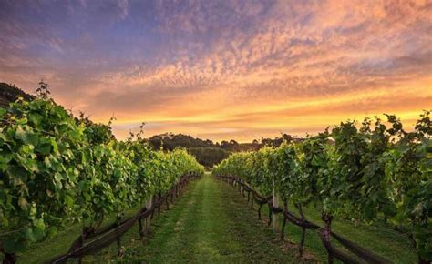
Agenda
Design and Analysis
Conceptual Data Model
Logical Data Model
Internal Data Model
External Data Model

Slide 3
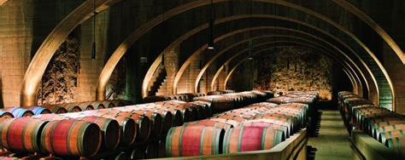
Design and Analysis
Business Description
Problem Statement
Database Solution
Chateau Cuse Vineyard
Three domains: HR, Sales, Production
Fully functioning vineyard from vine to bottle
On-site storage for aging
Online storefront
Orders processed with shipping partners
Many processes to keep track of
Grape's journey from vine to bottle
Bottle being ordered and shipped
Online storefront and customer orders
Working with shipping vendors
Quality control
Employee accountability
Three Domain Design
Business analyst can perform self-audits
Inventory management
Moderate production process
Track sales and revenue
Selection of future products
Track from vine to customer
Track employee pay and positions

Slide 4
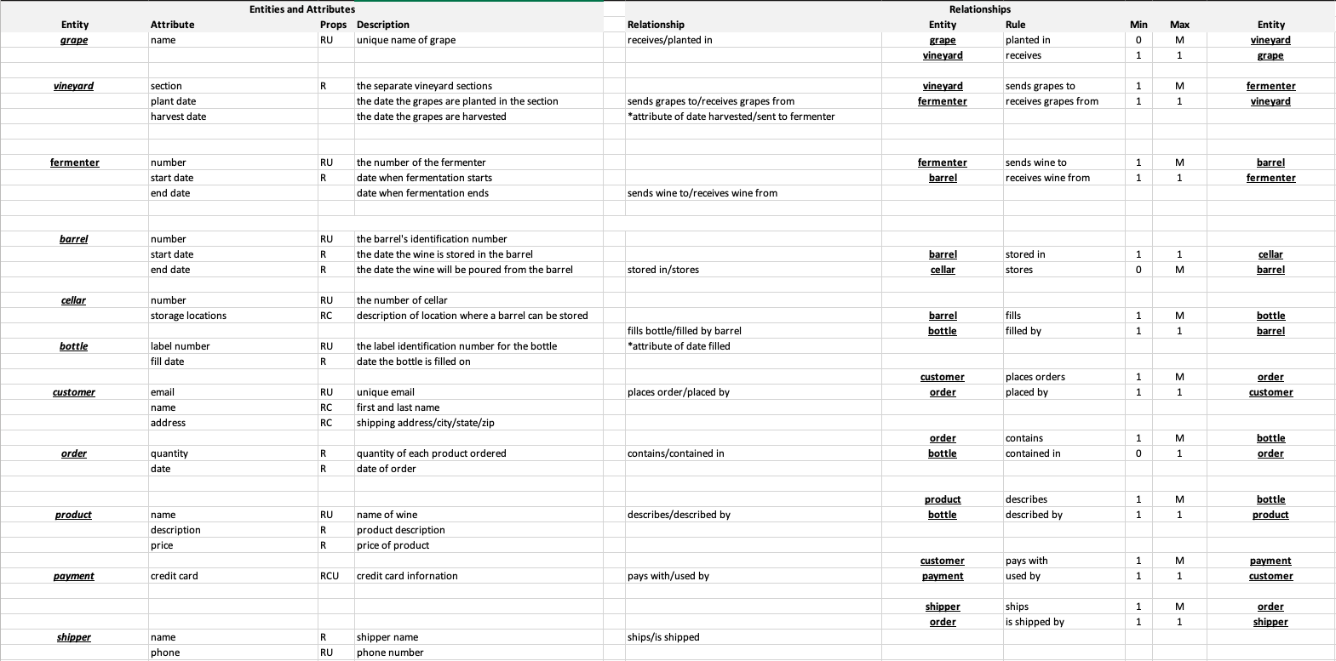
ERD - Requirements/Business Rules

Slide 5
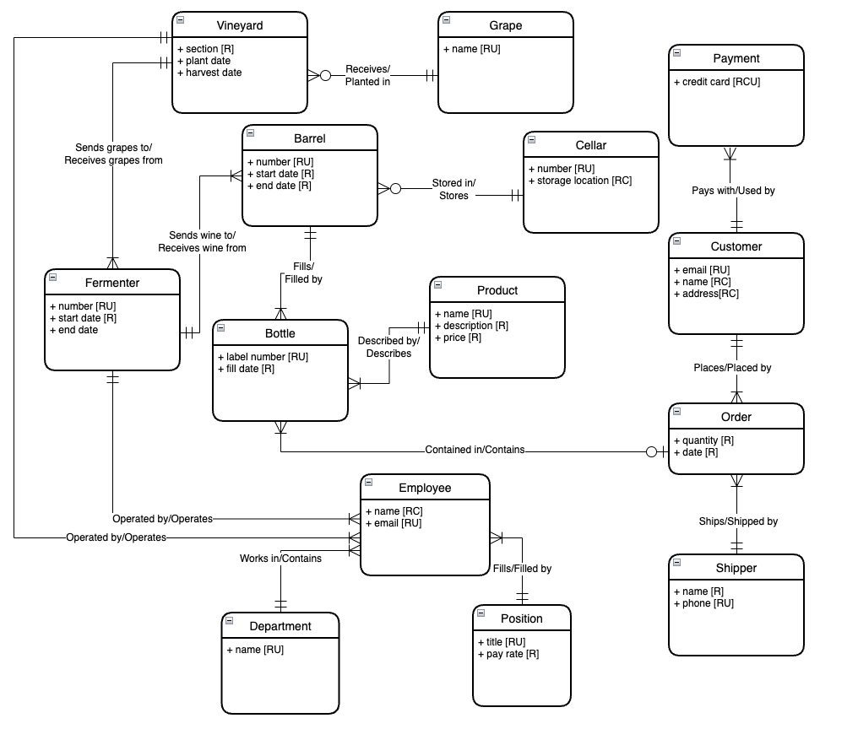
Conceptual Data Design

Slide 6


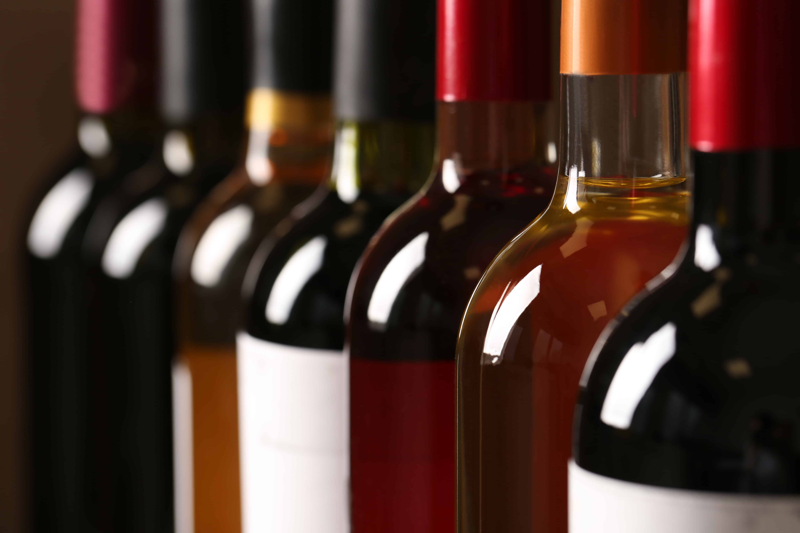
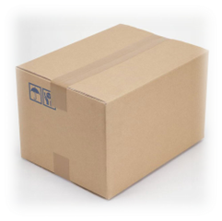
Order Data Flow
customer places
order on website and generates an order_id
payment is processed by payment_customer_id
order_bottle_id connects to inventory by bottle_id
shipper is selected by
order_shipper_id
and order is shipped to customer

Slide 7
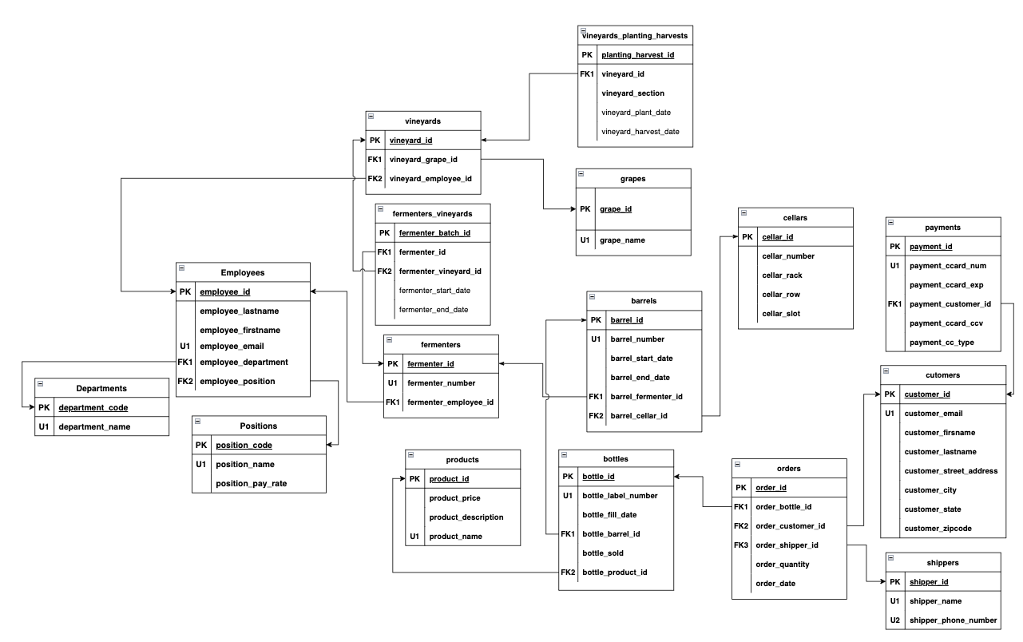


Slide 8
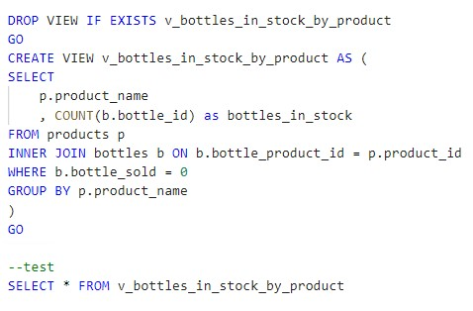
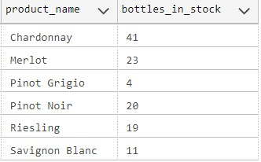
As a user, I would like to see how many bottles of wine we have in stock

Slide 9
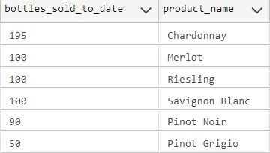
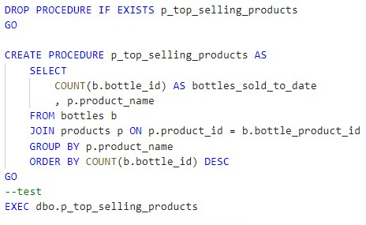
As a user, I want to see our top selling products

Slide 10
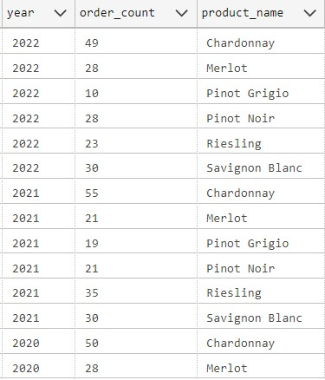
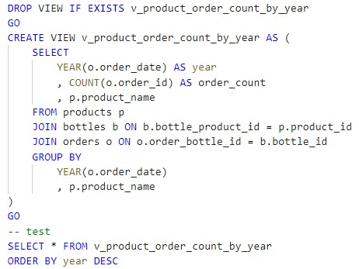
As a user, I would like to see how many orders we have had in 2022 and for what products

Slide 11

Application – Power BI
ChataeuCuse_Dashboard - Power BI

Slide 12
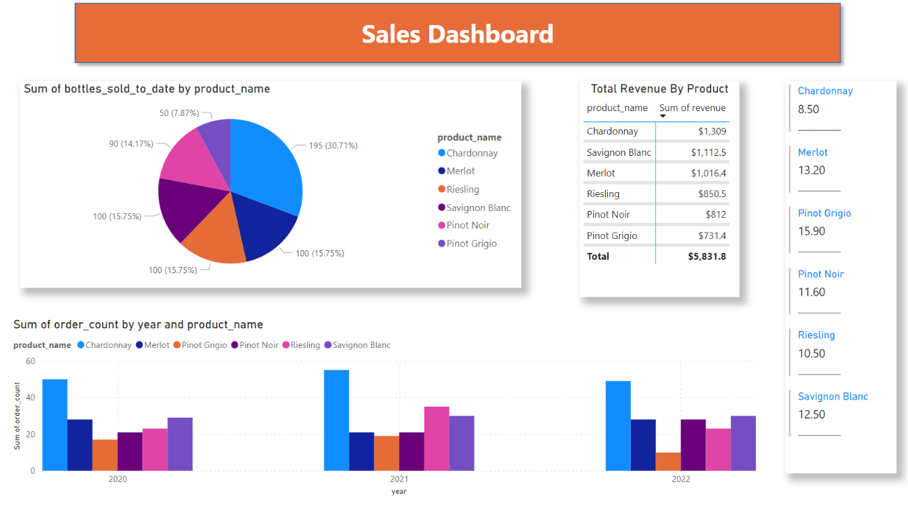
Sales Dashboard

Slide 13
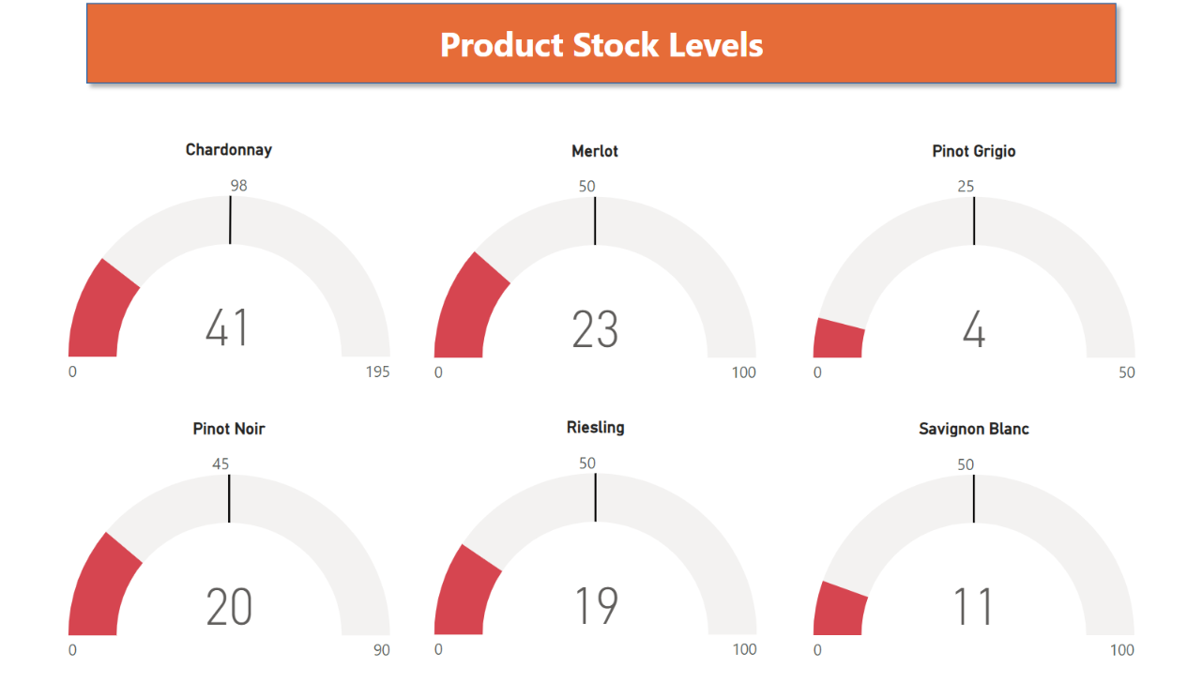
"Current Stock" Dashboard

Slide 14
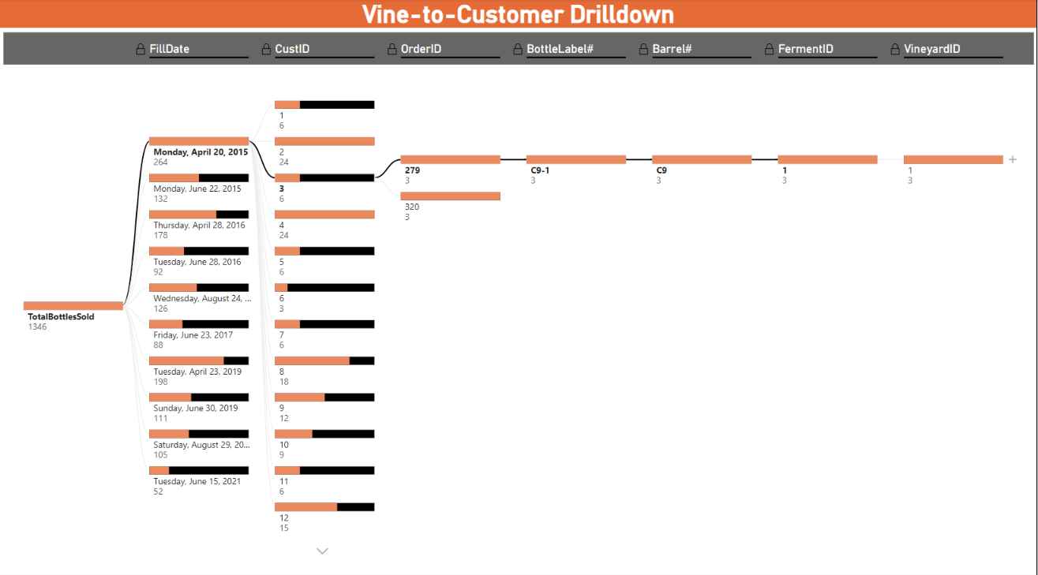
"Vine-to-Customer" Dashboard

Slide 15
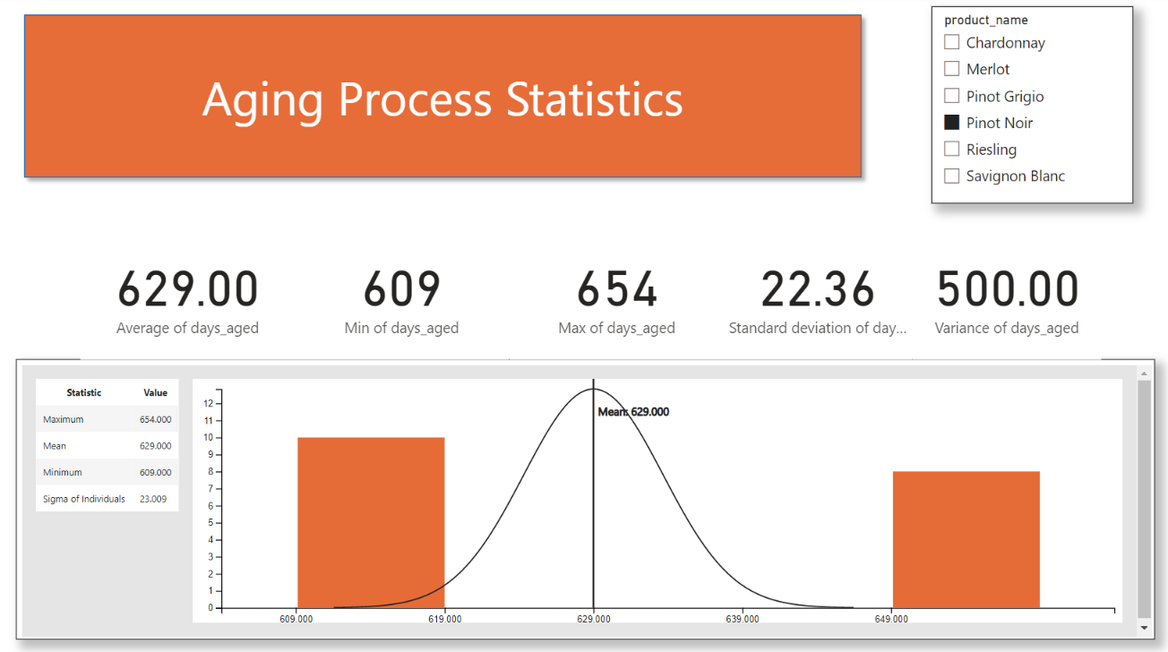
"Product Aging" Dashboard

Slide 16
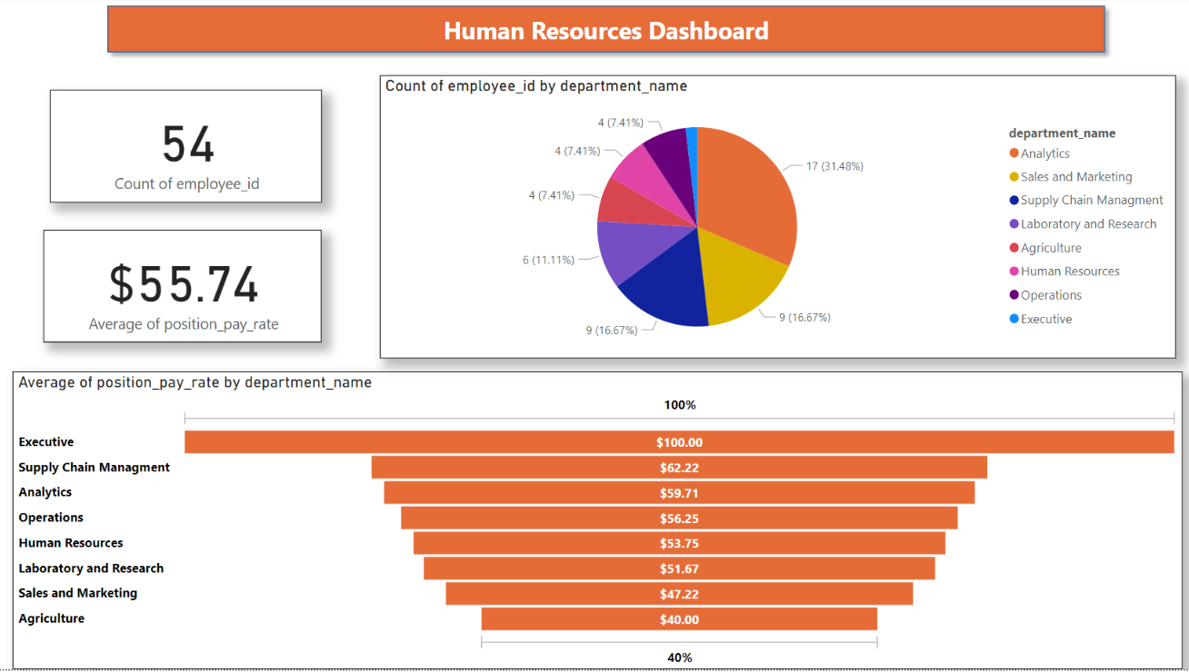
"Human Resources" Dashboard

Slide 17
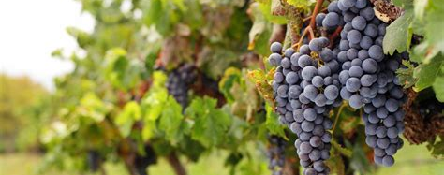

Q&A Thank you!

